Slide 1


CONTRACTUAL RIGHTS WHEN
RETIRING FROM
BERGEN COUNTY

Slide 2

Retiree Medical
If you were hired on or before June 27, 1991, you will not pay anything towards your Major Medical/RX if you reach 25 years of service in the PERS system
If you were hired on or after, June 28th, 1991, you will pay a percentage of medical BASED ON YOUR PENSIONABLE SALARY.

Slide 3
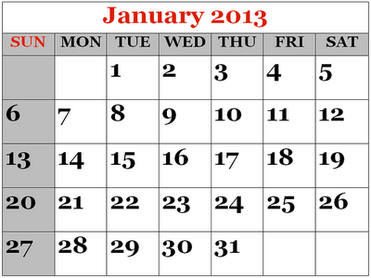


WHO Is Eligible?
If Hired before JANUARY 1, 2013
          MUST HAVE 25 Years in the PERS
  If Hired After January 1, 2013
  Must HAVE 25 years in PERS and
          Earned those years working as a Bergen County Employee

Slide 4


If you are Medicare eligible (Age 65), Medicare becomes your primary insurance covering approximately 80% of your medical costs. The County will become your secondary.
Primary Premium Rate (based on Choice of Plan) MULTIPLIED by Percentage (as Calculated by your Pensionable Salary) plus any additional costs (Optional Dental)(Medicare Part B)
Or
Secondary Premium Rate MULTIPLIED by Percentage (as Calculated by your Pensionable Salary) plus any additional costs (Optional Dental)(Medicare Part B)

Slide 5
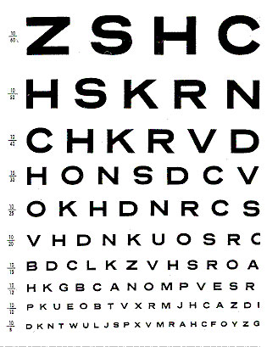





RETIREE Medical (Continued)
Medical after retirement does not cover
Dental or Glasses
Eye Glasses are contractual and no longer covered.

Slide 6


USWU Retiree Chapter
The valued relationship we have built with you over the years shouldn’t end here! The United Service Workers Union can continue to help you improve your life by offering you benefits and services that are FREE with your membership.
USWU is offering a special Retiree Chapter membership for the low price of $30 per month.
Spouses of active retiree members are welcome to join as well and receive their own membership.

Slide 7

Benefits that come with RETIREE CHAPTER dues include:
FREE Medicare Advantage Program
FREE Hearing Care Program*
FREE Dental Plan
FREE Vision Coverage
FREE Rx Discount Card
FREE access to the UBenefit Program - which includes discounts on auto and homeowners insurance, travel and entertainment, shopping and many other services.
Access to all union publications and communications
Eligibility to earn extra money by participating in our Member Organizer Program
* With enrollment in enhanced Medicare Plan
USWU RETIREE CHAPTER
https://www.uswu.org/retirees-1

Slide 8

SICK TIME
Terminal Leave
  ½ of your sick time
  Up to $20,000 or $15,000
  All employees hired on or before December 31, 2011 shall be capped as to terminal leave at fifty (50.0%) percent of accumulated sick leave not to exceed Twenty Thousand ($20,000.00) Dollars.
  Employees hired after December 31, 2011 and before January 2, 2018 shall be capped as to terminal leave at fifty (50%) percent of accumulated sick leave not to exceed Fifteen Thousand ($15,000.00) Dollars.
  If hired after Jan 1 2018 – NOT ELIGIBLE!
ASK PERSONNEL ABOUT ROLLING YOUR SICK LEAVE INTO YOUR DEFERRED RETIRMENT ACCOUNT

Slide 9

Vacation and Personal TiME
Your Vacation bank will be paid out
PERSONAL LEAVE TIME
THE COUNTY AS A POLICY DOES NOT PAY OUT PERSONAL TIME,
BUT IT CAN BE USED BEFORE RETIRING
ASK PERSONELL ABOUT ROLLING YOUR VACATION BANK INTO YOUR DEFERRED RETIREMENT ACCOUNT

