Slide 1


Fire Warden Training
Bergen County Fire Marshals Office

Slide 2

Purpose of Fire Wardens
Ensure the safe evacuation of staff and visitors
Make sure everyone is out – even if you think it is a drill
Act as a point of contact for Fire Emergencies
Support various emergency services upon arrival

Slide 3

Why does this matter?
Government Buildings = High occupancy & public traffic
Visitors may not know building layout and exits
Quick, organized response saves lives

Slide 4

Fire Warden Responsibilities
Make Sure that you know where all exits are and which is your primary
Know where your extinguishers are located
Keep exits, corridors & stairways clear
Roles with multiple Wardens ( One Leads the people to safety and the Second will be the last to one out after checking their areas)
Check their work area to ensure no fire safety hazards exist and all appropriate exit signage is in place.
Report any hazards immediately

Slide 5



Emergency Response: The AAA Rule
AAA = Activate, Assist, Attempt
Activate: Sound the alarm and/or call 911
Assist: Help others evacuate safely
Attempt: Only fight a small fire if safe and trained to do so

Slide 6

Fire Warden Responsibilities: During Alarm
Direct staff & visitors to exits
Assist mobility-impaired persons
Close doors to contain smoke/fire
Follow AAA as your guide

Slide 7
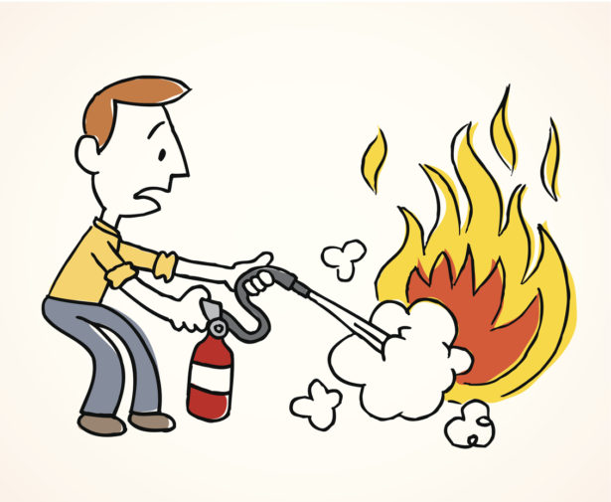
Fire Extinguisher Basics
Use only if:
The fire is small and contained
You have a clear exit path
You feel trained and safe
If in doubt → Evacuate immediately

Slide 8
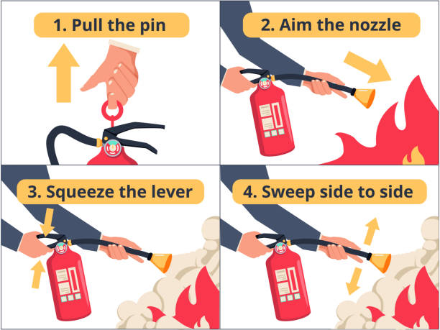
P.A.S.S. Method for Fire Extinguishers
How to operate a Fire Extinguisher:
Pull the pin
Aim the nozzle at the base of the fire
Squeeze the handle
Sweep side to side

Slide 9

Evacuation Procedures
Leave immediately when the fire alarm sounds
Use nearest safe exit (Never utilize elevators)
Go to assembly point: Kansas Street DPW Lot
Never Leave the Evacuation Area until you are given the all clear and Never attempt to leave in your vehicles.
Fire Wardens must account for all staff and visitors

Slide 10

Assembly Point & Roll Call
Fire Waden shall conduct a headcount.
Report any missing persons to the Fire Department.
Do no re-enter the building until cleared to do so.

Slide 11
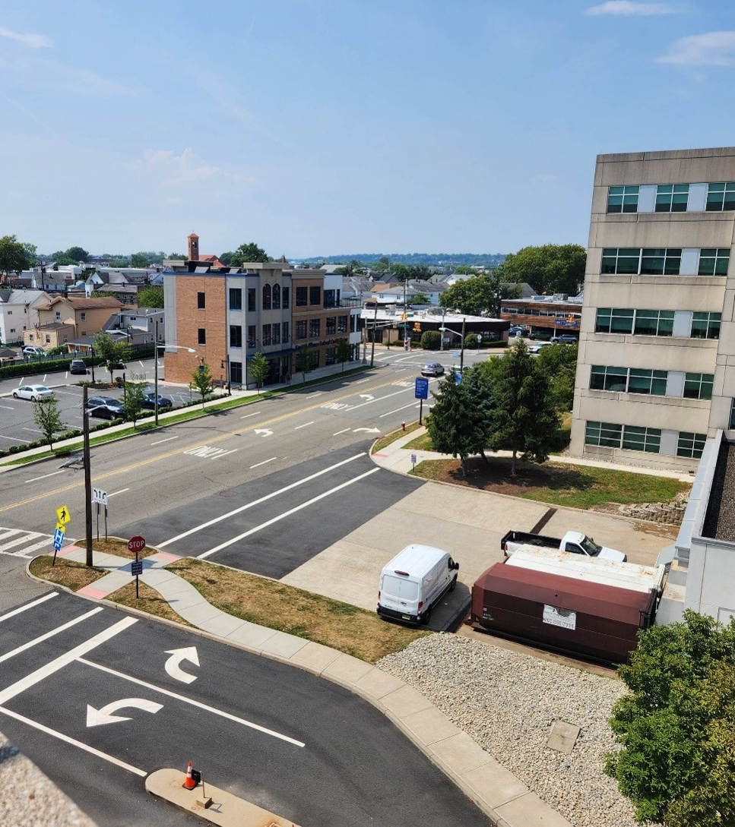
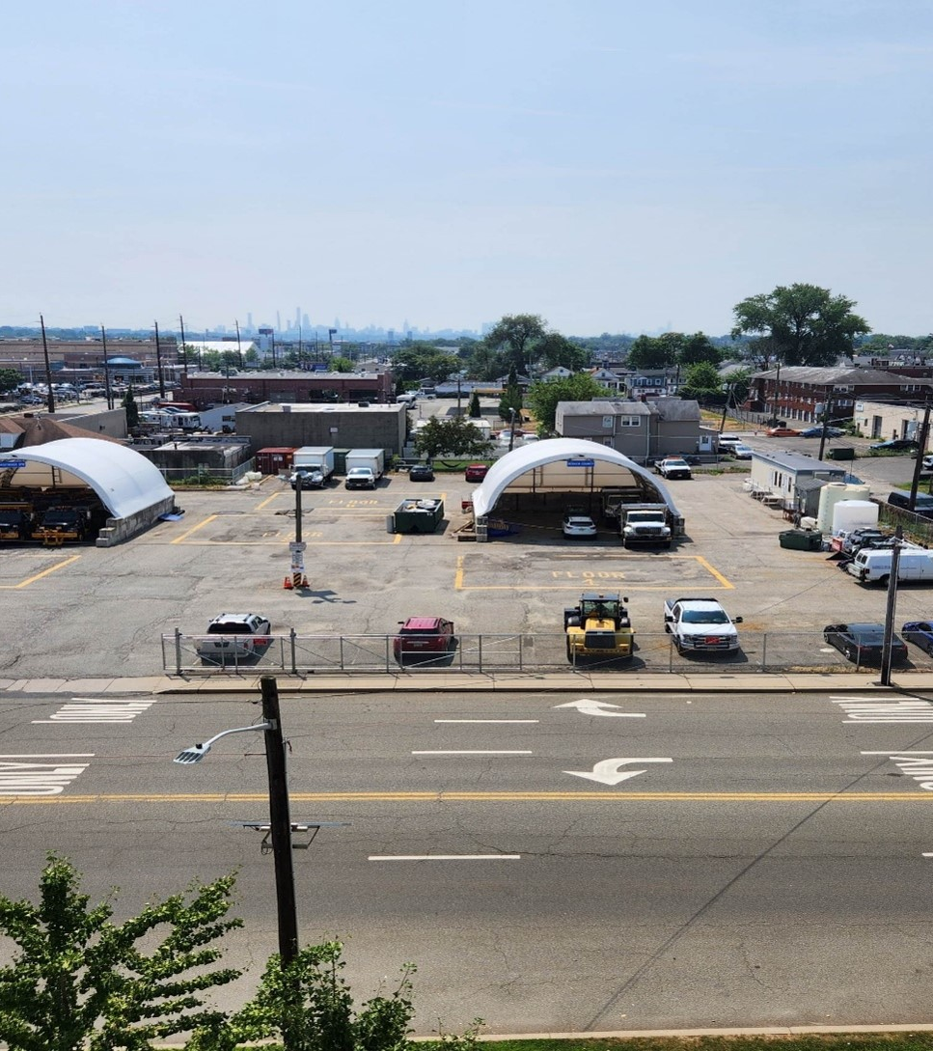
One Bergen county plaza – assembly point
The current evacuation point of OBCP is the DPW lot on Kansas Street. Occupants will need to cross Kansas street near the loading dock.

Slide 12
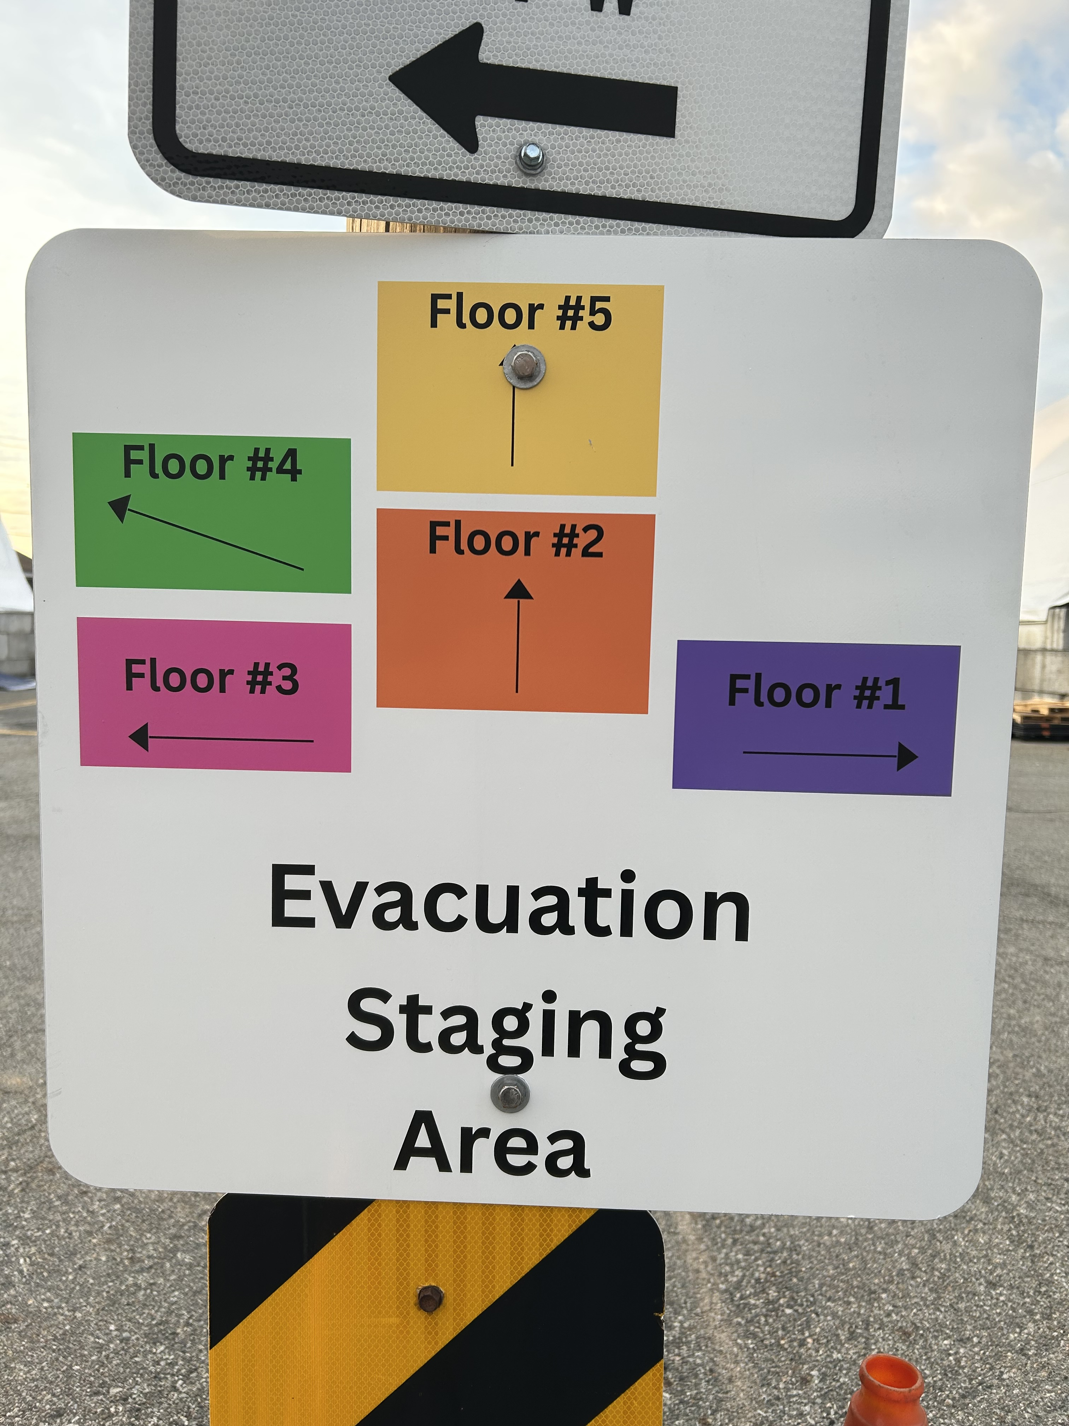
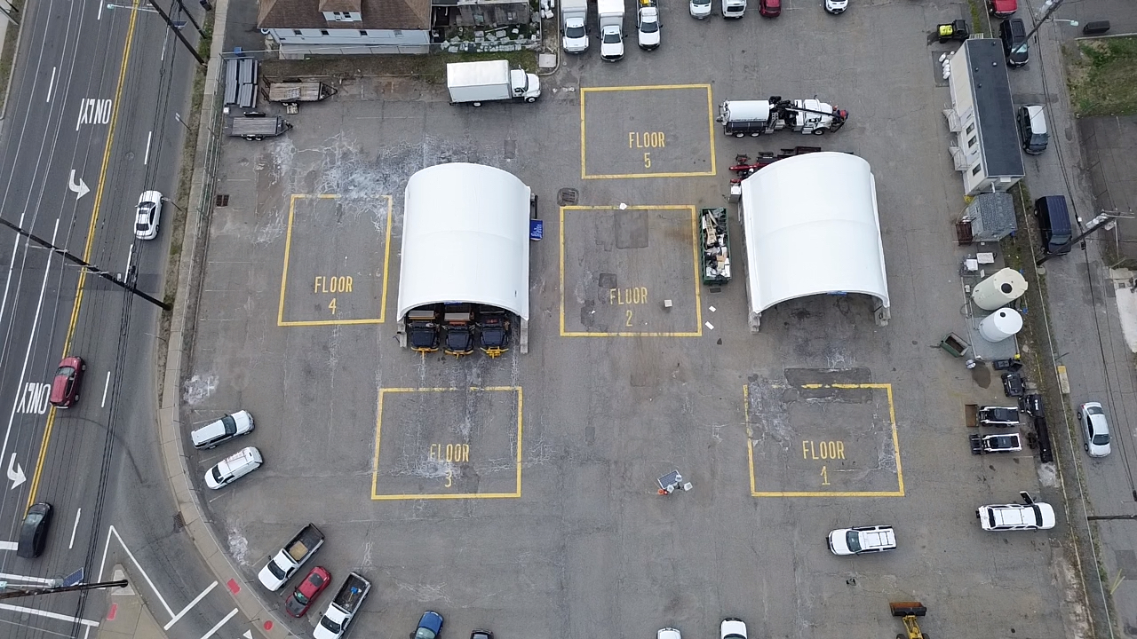
Kansas street lot
The Kansas street lot has an information sign directing occupants to a specific area by floor number. A fire warden will be equipped with a matching colored sign to assist in directing occupants.

Slide 13
Special Considerations for Fire Wardens
Public Areas: Visitors may be unfamiliar with the area and need further direction.
Secure Areas: May be unlocked if safe to exit through
Staff with disabilities → Assign a buddy system

Slide 14
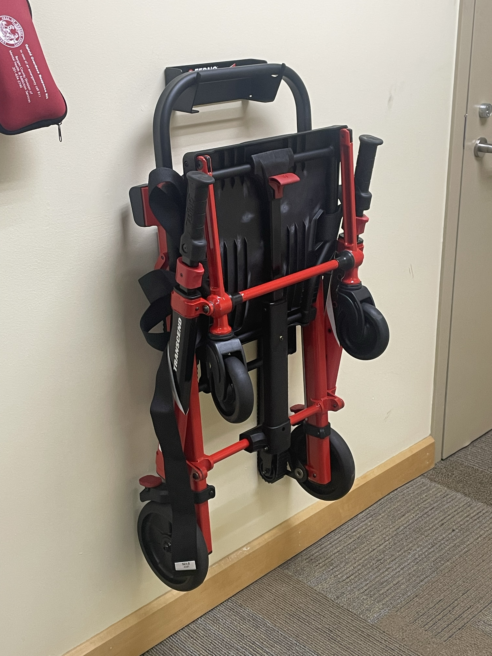
What is this??
Does anyone know what this is and/or what it is used for?

Slide 15
This is a stair chair
A stair chair, also known as an evacuation chair is a foldable device designed for the safe transport of individuals with limited mobility, such as patients or disabled persons downstairs during emergencies or in situations where elevators are unusable

Slide 16
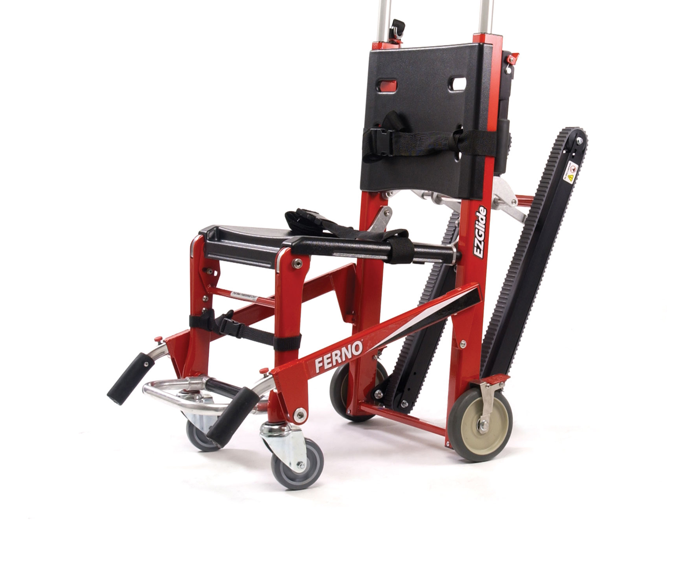
What kind of stair chair do we have?
The County of Bergen has Ferno Model 59 stair chairs strategically placed throughout One Bergen County Plaza.
Unfolded, the unit looks likes the photo.

Slide 17
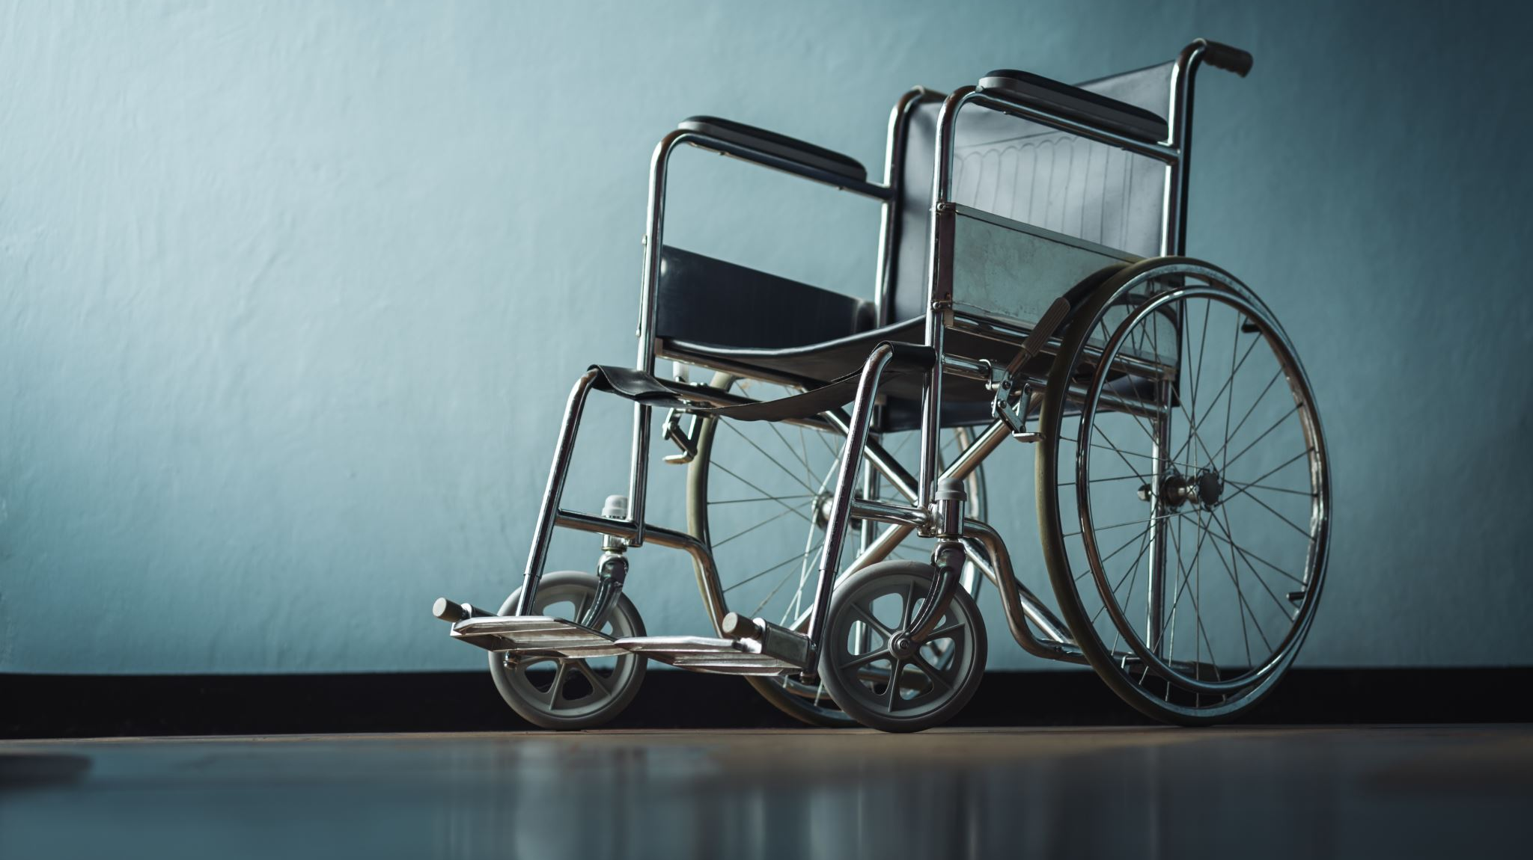
How do I use a stair chair?
Preparation & Securing the Patient
Deployment: Unlock and deploy the chair's handles and stabilizing rear wheels to prepare it for use.
Patient Placement: Place the patient in the chair and secure them with the chair's restraints, ensuring they are snug but not overly tight.
Operator Position: Decide on the number of operators (two or three recommended). One operator stands at the head of the chair (highest point) and the other at the feet (lowest point), with a third as a spotter if needed.

Slide 18
Moving the Chair
Lifting: With proper lifting technique, operators simultaneously lift the chair, keeping their backs straight and using firm, stable footing.
Traction: As you begin moving down the stairs, the head-end operator applies upward pressure on the handles while the foot-end operator applies downward pressure to control the descent and create a stable angle.
Controlled Movement: Proceed slowly and steadily, ensuring the chair's treads remain level across the edges of the steps.
Communication: Operators must maintain communication, calling out steps or obstacles.

Slide 19

Reaching the Landing
Top Landing: At the bottom of the stairs, you may need to angle the chair slightly to get the rear wheels flush with the landing area.
Flat Surface: Once on a flat surface, the chair can be used like a wheelchair.

Slide 20

Post Incident Duties
Confirm staff accountability.
Complete an incident report, if required.
Participate in a debrief.

Slide 21

Fire Wardens 5 Golden Rules
Stay Calm – Take Charge
Follow AAA
Do not put yourself at risk
Always assist others
Never re-enter until cleared

Slide 22

Scenario Example
You see a trash can on fire on the second floor. What do you do?

Slide 23

Summary
Fire Wardens = Leadership in Emergencies
Know the building, know your role
Remember, AAA and PASS save lives.
Always remember if there is a presence of smoke stay low to the ground when evacuating

Slide 24

Questions and Contact
If you have any questions or concerns, please email: BCFM@BergenCountyNJ.gov
Fire Marshal -Tim Ferguson
Assistant Fire Marshal- Sean Redl

